Slide 1
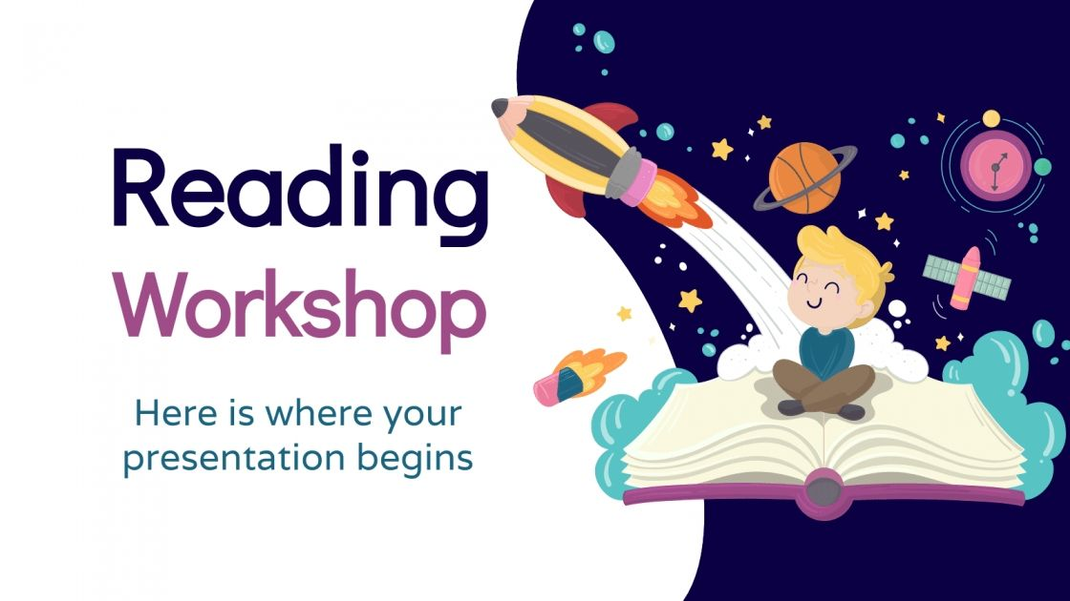

Children’s Books
Natural Language Processing
&
Unsupervised Learning
Ahmad Hakami | Nouf Alshabani | Abdumajeed Alnfaie

Slide 2
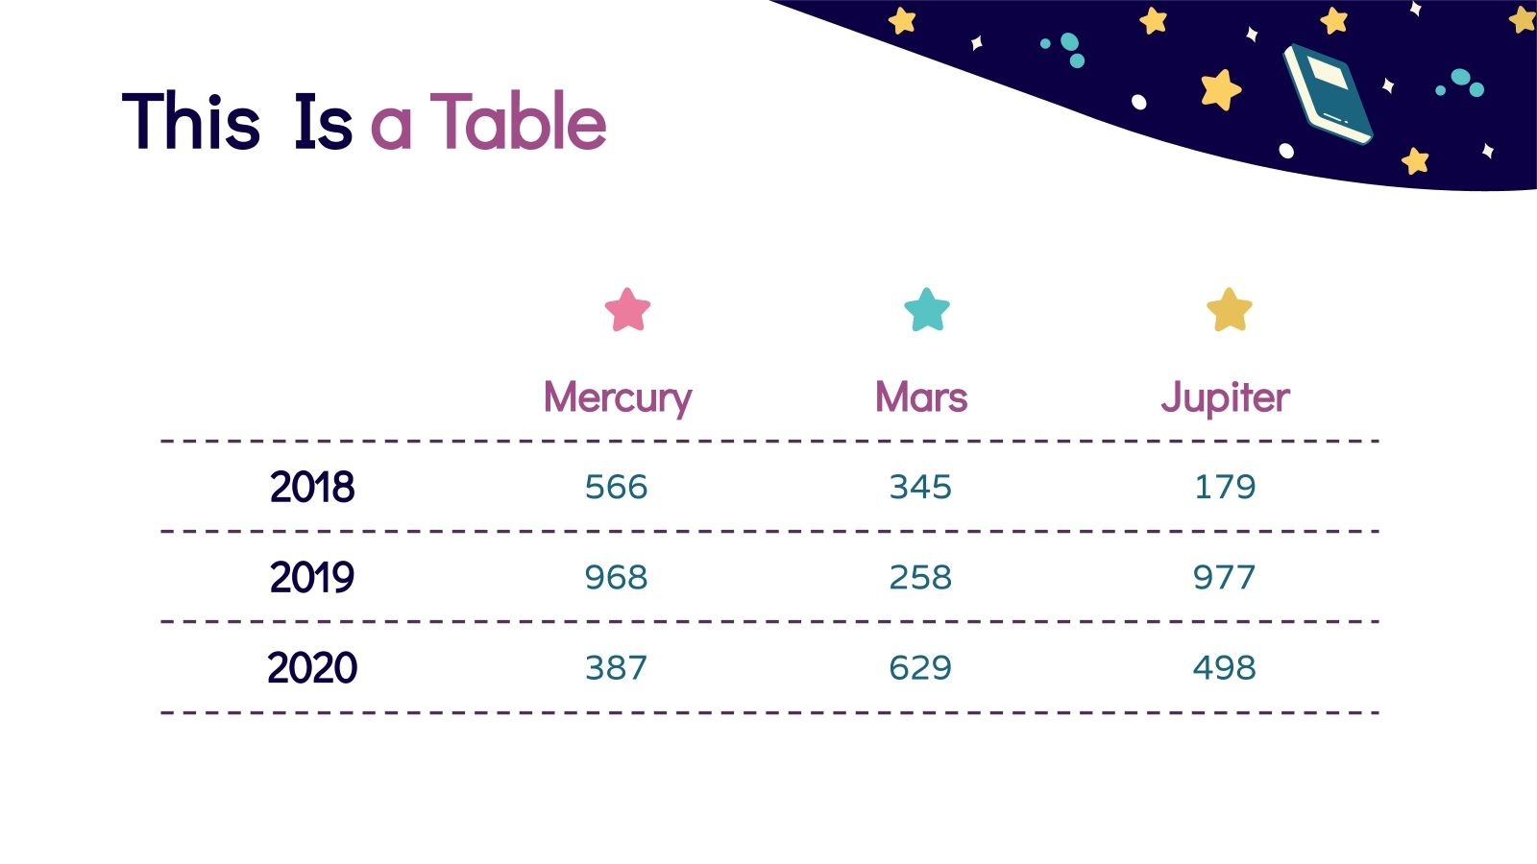

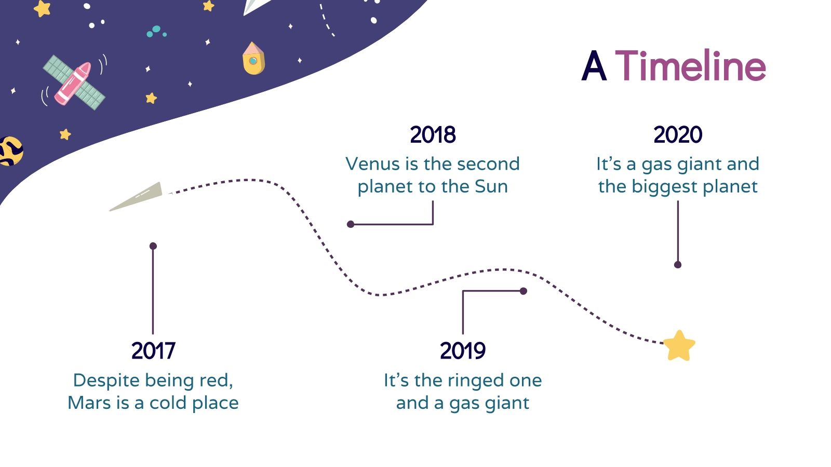
Agenda
5. Recommender Systems
3. Preprocessing
1. Introduction
6. Recommender Systems
4. Features Extraction
2. Dataset

Slide 3
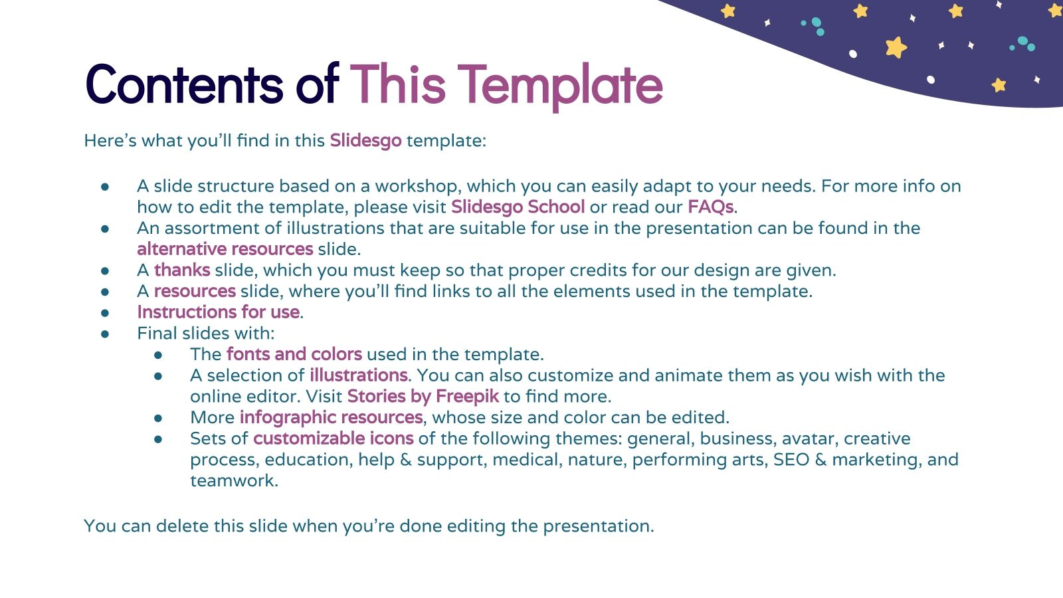
Introduction
The importance of reading to children cannot be underestimated. Reading for pleasure can benefit a child's education, social and cognitive development, well-being, and mental health. The effect of reading on a child's development is significant. Research by BookTrust has discovered the profound benefits of reading for child development, facilitating social interaction between adults and children, and encouraging children to interact with the world around them.
Inspiration
Teachers and parents are in an important position to ensure that reading is an essential part of children's daily routine. We 'll give them a system that recommends books based on the child's interests and age.

Slide 4
Methodology
Methodology
Upload Data
EDA
Preprocessing
Features
Extraction
Recommender
Systems
Unsupervised Learning

Slide 5
Dataset
Source
Highly Rated Children Books And Stories
It was uploaded in Kaggle.com
Features
3269 Books
Columns
5 Columns
Title, Author, Desc, Inerest_age, Reading_age, They are all OBJECT!
Target
Building a system to recommend books by age

Slide 6
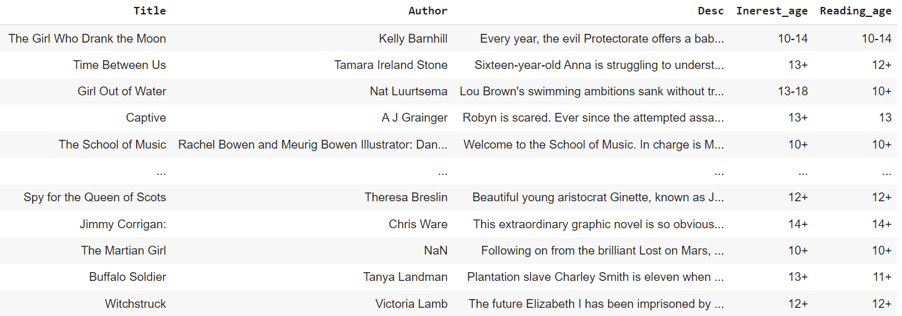
Dataset
Title, Author, Desc, Inerest_age, Reading_age
Building a system to recommend books by age

Slide 7
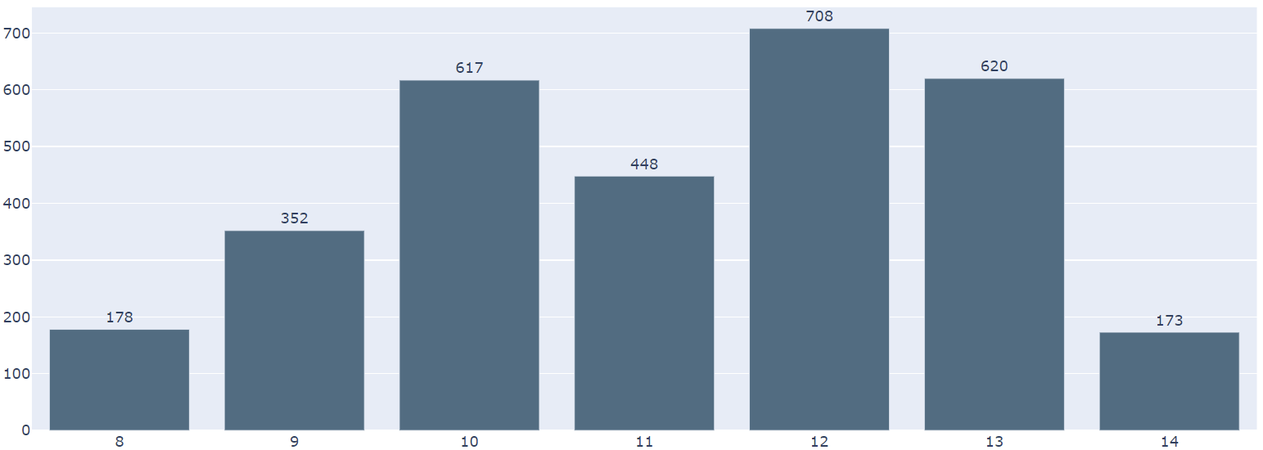
Exploratory Data Analysis
What is the most common age that writer targets?
Drop Null Values.
Reset index.
Change columns types.
Number of books
Ages
The most mentioned books in the database are for 12 years old

Slide 8
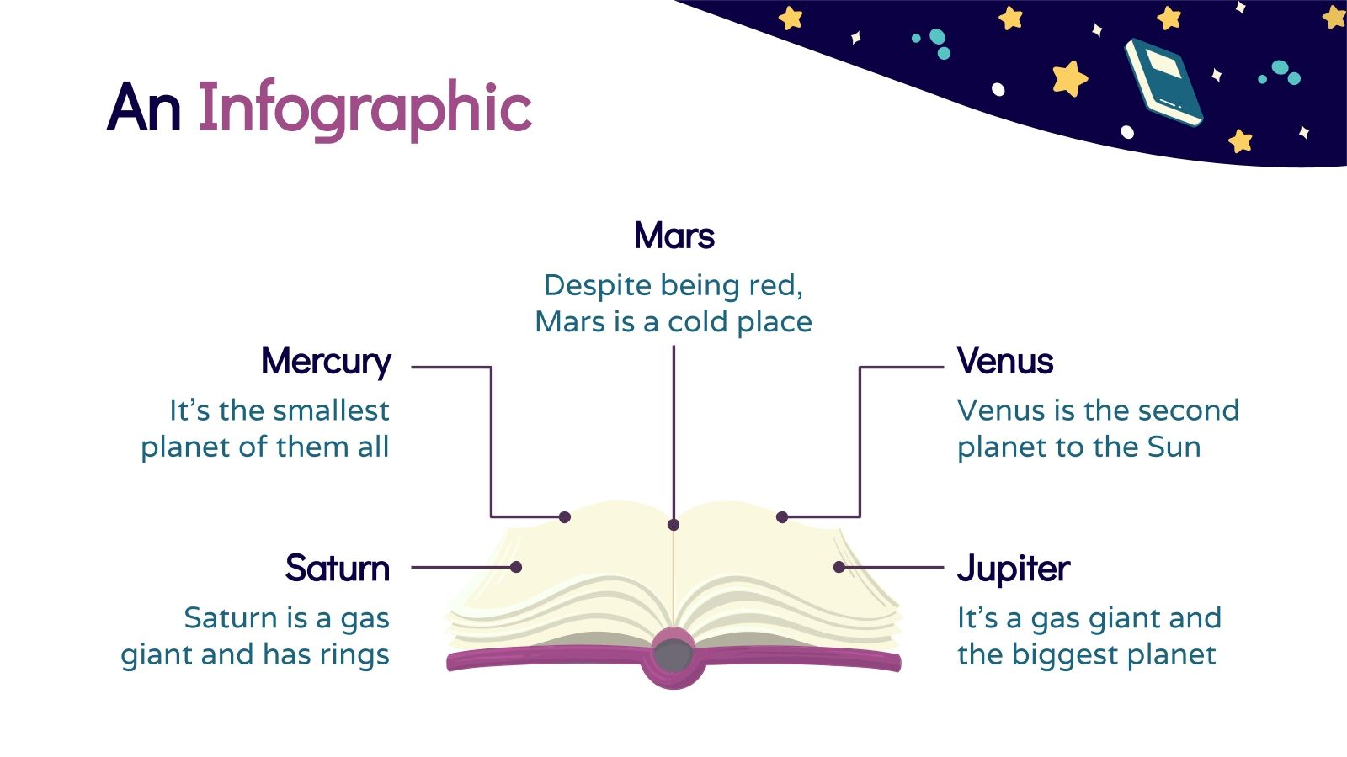
Preprocessing
Tokenize
Breaks the sentence text into words.
Lemmatization
The processes of grouping together the different inflected forms of a word so they can be analyzed as a single item.
Punctuation
To remove the punctuations from the text data.
Stopwords
Remove stopwords are common words in the language.
Lower case
To convert the input text to lower case.

Slide 9
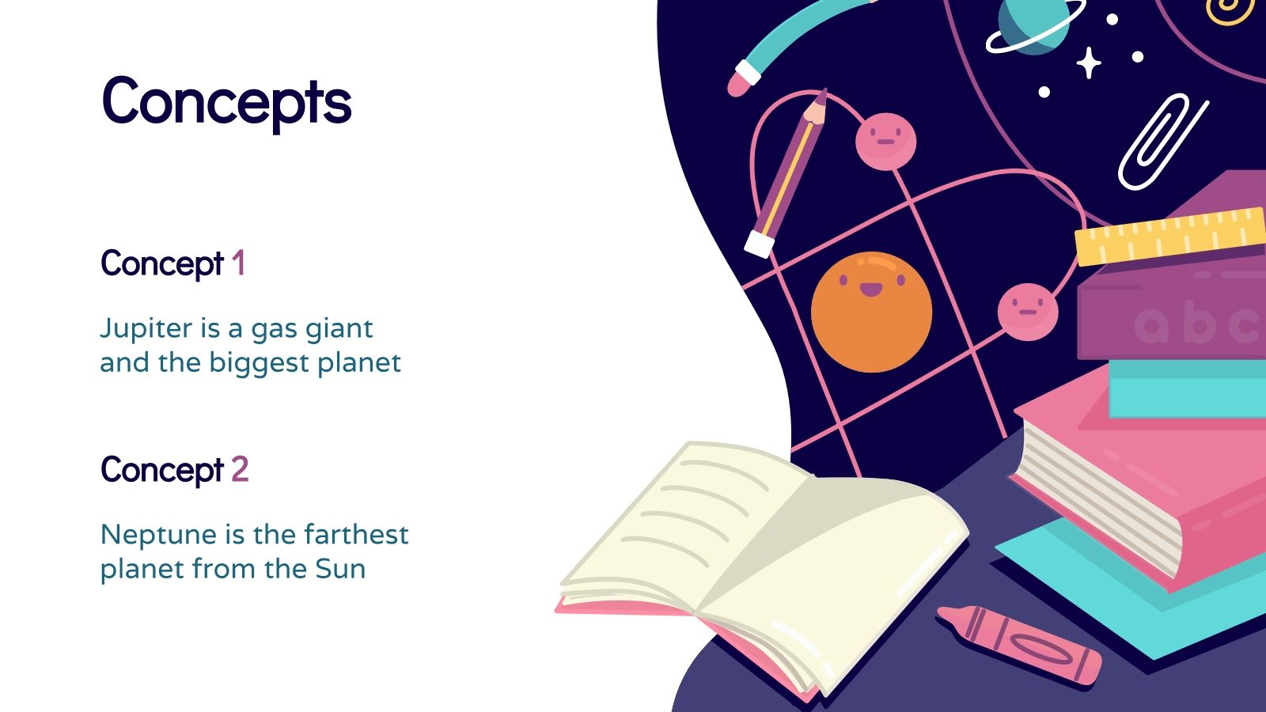
Feature Extraction
Countvectorizer
is a way to convert a given set of strings into a frequency representation.
TF-IDF
focuses on the frequency of words present in the corpus and provides the importance of the words.

Slide 10
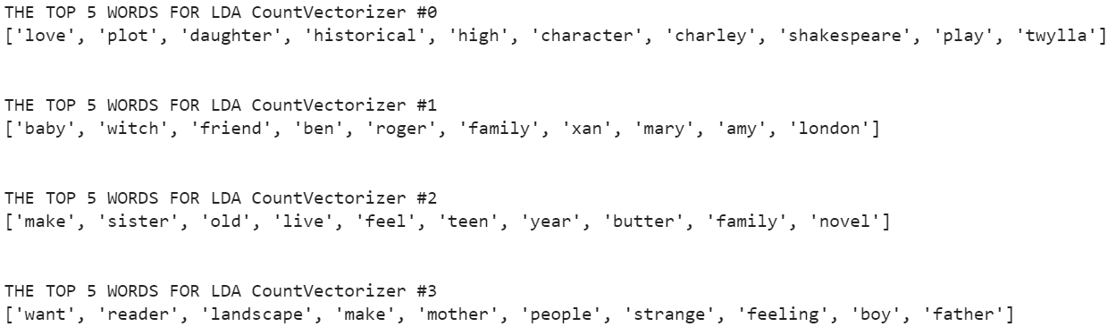
Unsupervised models
Latent Dirichlet Allocation, Countvectorizer
1lower
punctuation
Stopword
lemmatizer

Slide 11
Unsupervised models
Latent Dirichlet Allocation, Countvectorizer
1lower
punctuation
Stopword
lemmatizer

Slide 12
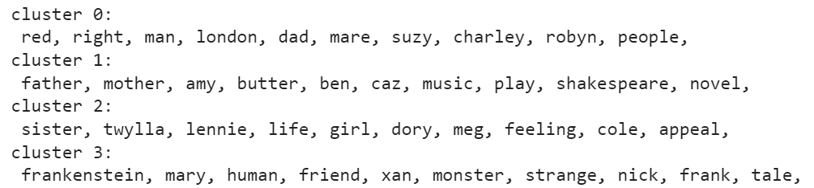
Unsupervised models
K-means Clustering, TF-IDF
1lower
punctuation
Stopword
lemmatizer

Slide 13
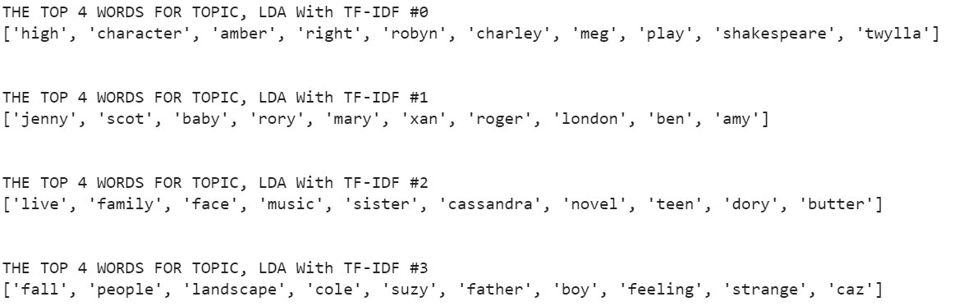
Unsupervised models
Latent Dirichlet Allocation, TF-IDF
1lower
punctuation
Stopword
lemmatizer

Slide 14
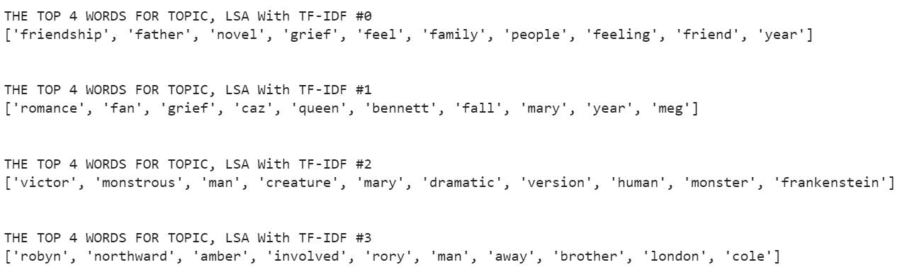
Unsupervised models
Latent Semantic Analysis, TF-IDF
1lower
punctuation
Stopword
lemmatizer

Slide 15

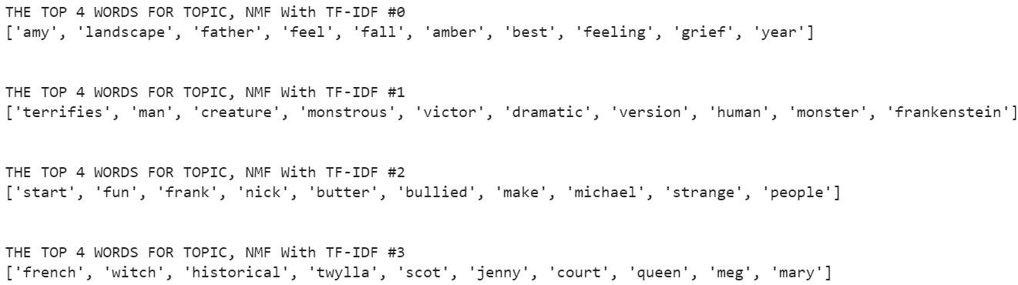
Unsupervised models
Non-Negative Matrix Factorization, TF-IDF
1lower
punctuation
Stopword
lemmatizer

Slide 16
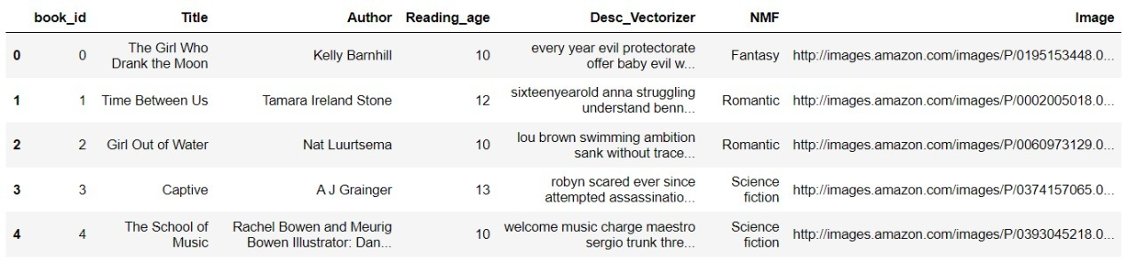
Dataset After Preprocessing
1lower
punctuation
Stopword
lemmatizer
NMF: Fantasy, Romantic, Science fiction, Science

Slide 17


Recommender
Systems
Recommender
Systems
Let’s see the web-site !

Slide 18
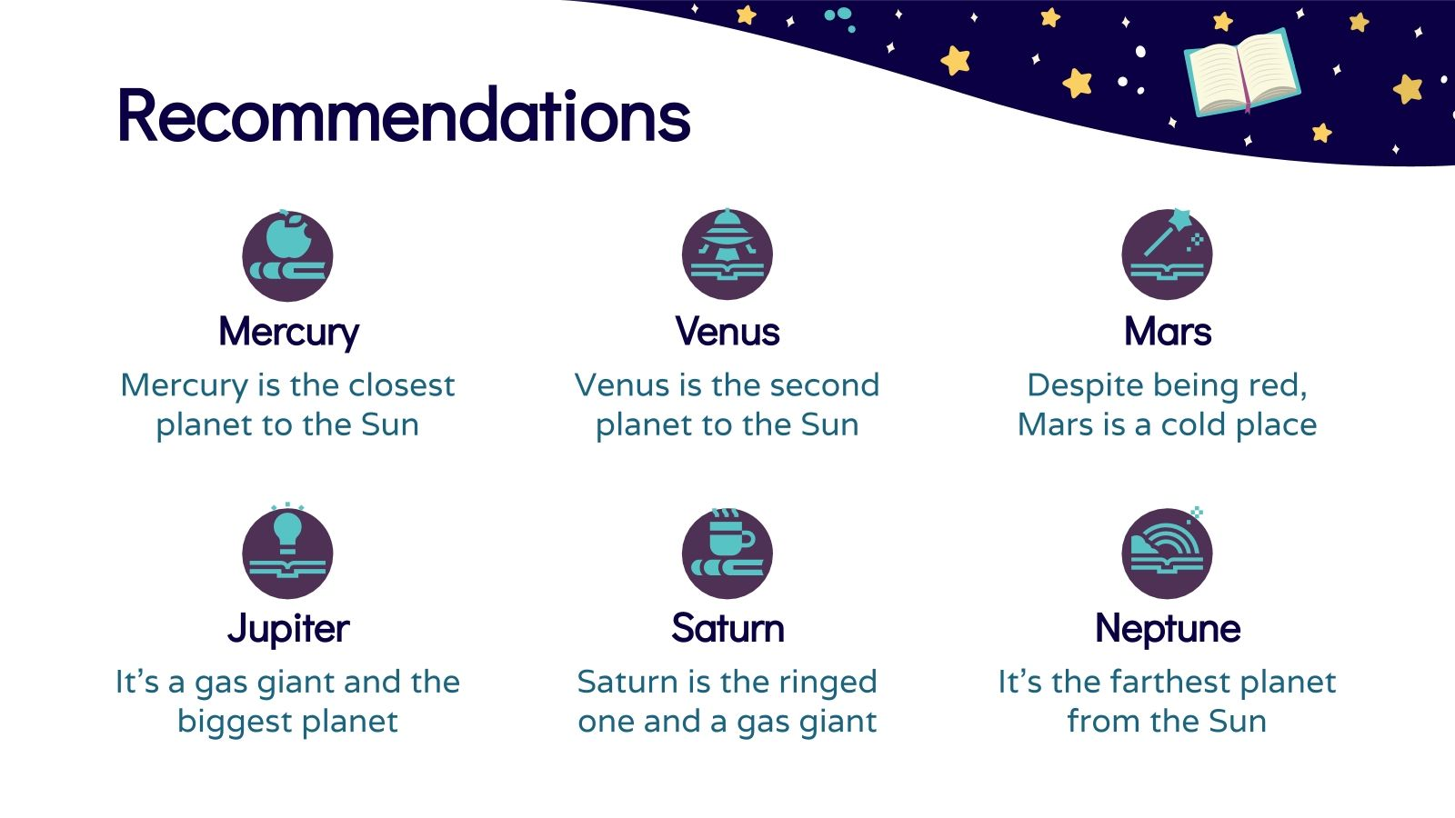








TOOLS
Plotly
Jupyter Notebook
Scikit learn
Python
Pandas
PyCharm
Streamlit

Slide 19
Conclusion
Conclusion
To make reading fun and educational for children, it is necessary to focus on their interests and ages to choose the best books and help them develop their imagination in the best way.

Slide 20

Thanks!
Thanks!
Do you have any questions?
Do you have any questions?
Abdulmajeed
Nouf
Ahmad
Github @AbdulamjeedAlnefaie
Github @NoufAlshabani
Github @AhmadHakami

Slide 21
Invitation
For everyone interested, We are pleased to invite you to attend our project on Natural Language Processing, Children’s Books as a model. We ‘ll be presenting on Thursday, 30 December at 11:00 am.
Supervised by Dr. Patrick Saoud.
Dr. Patrick Saoud

